Slide 1


Prototype Submission Phase
Presenting
FINANCIFY
By Brown Devs

Slide 2
1
Introduction to the Team
2
Problem Statement
3
Idea
4
Solution
CONTENTS
5
Methodology
6
Features
7
SWOT Analysis
8
Future Prospects
9
Working Prototype

Slide 3
TEAM AND MEMBER DETAILS
ADAMAY MANN
ISHAAN BHOLA
DARSHAN PATEL
Theme: Financial Technology / FinTech
Team Name: Brown Devs
Project Name: Financify

Slide 4
PROBLEM STATEMENT
Here we have defined the exact PROBLEM that we intend to solve.
We make transactions every day, and we are never consistent. We use cash, card, or digital wallets and it gets very difficult to actually track where our money goes by the end of the month. We need one single platform for us to track our transactions and help analyze how we can be smart consumers to save as much as possible by spending as little as possible. Rather than going through all the bills at the end of the month, what if we could just click a photo and everything else happens automatically?

Slide 5
IDEA
Our idea is to make the life of consumers easier and make them smart spenders.
Firstly, we want to help users track and analyze their spending in an efficient and easy way. At the end of a month, they should be able to see a page and get to know everything about their spending in the last month.
Secondly, we want to eliminate the mundane task of recording transactions manually, and make it as easy as clicking the photo of the receipt.
Moreover, we encourage users to set goals and help track their progress towards it.

Slide 6
SOLUTION
1
Our hack will help a person to manage all the finances at one stop, thus, acting as a budget tracker.
A Web App
FINANCIFY
2
Users can analyze their data in a way which is easy and efficient. No need to go through months of bills
3
We have eliminated the mundane task of recording transactions manually, and made it as easy as clicking the photo of the receipt.
Imagine that our project is a ship sailing to the islands that represent our goals. What factors can help or obstruct our ship's voyage? There are questions we have answered to add structure to our project journey.
4
Unlike other budget trackers , we can record recurring subscriptions and see how much we actually have left to spend

Slide 7
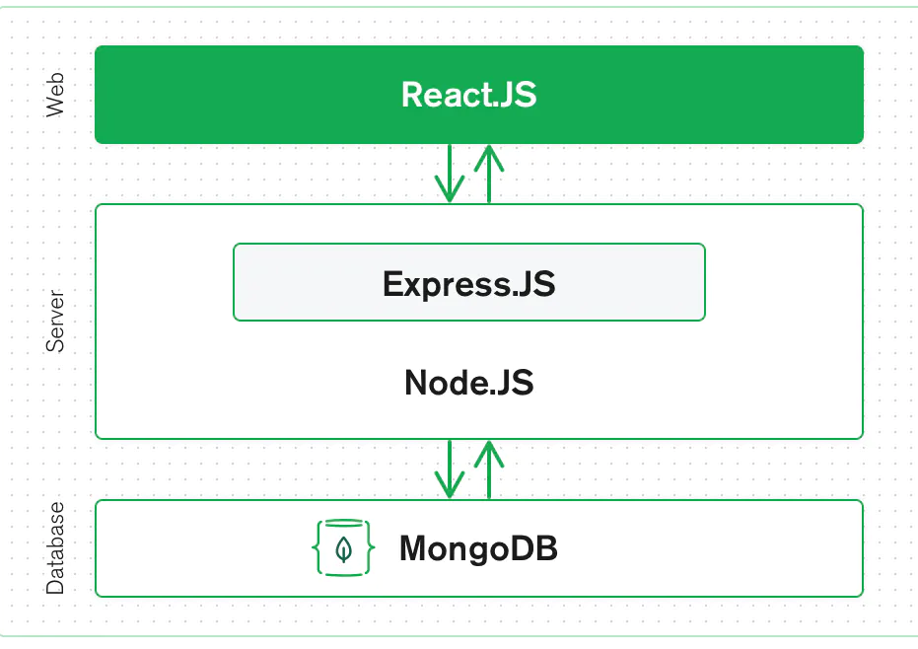
METHODOLOGY
1
We have used MERN stack as the tech stack. (Mongo DB, Express.js, React.js, Node.js).
Website being complete responsive can be used easily on the mobile and Web , hence the choice of a web application.
2
ARCHITECTURE DIAGRAM

Slide 8
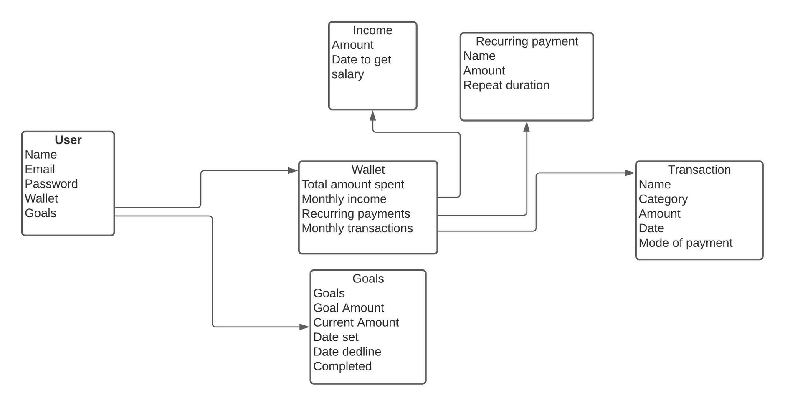
METHODOLOGY
3
DATABASE DESIGN

Slide 9

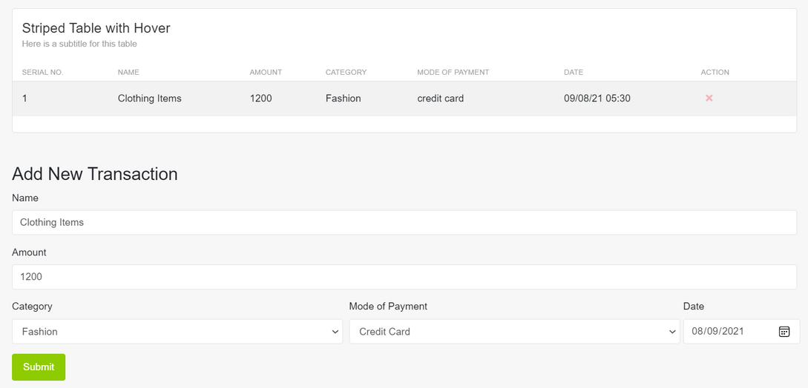
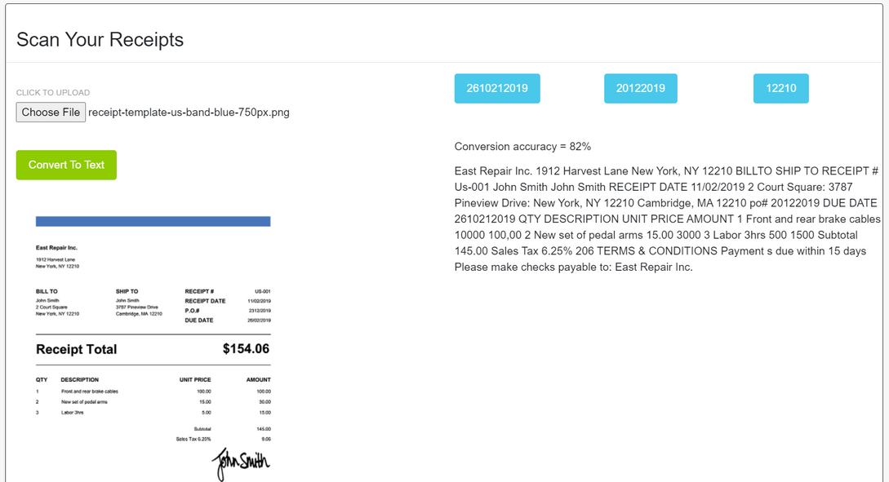
Features
1
Manage transactions and subscriptions.
2
Scan your receipts and add them as transactions

Slide 10
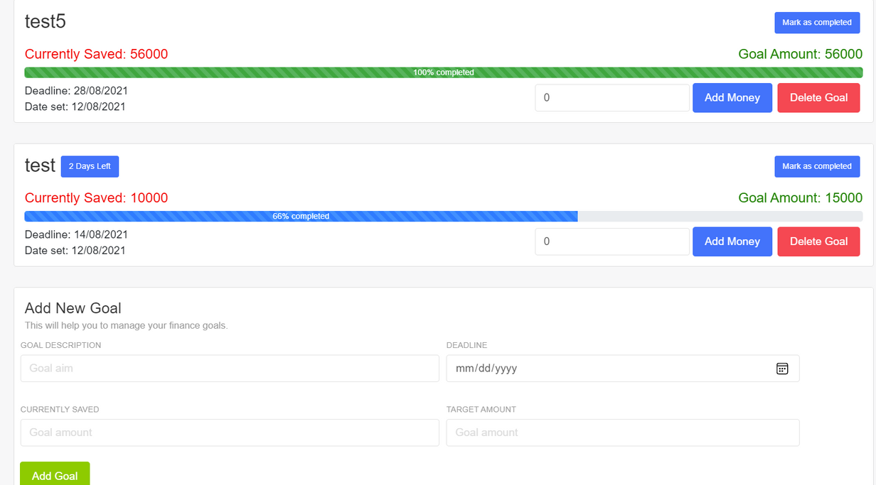
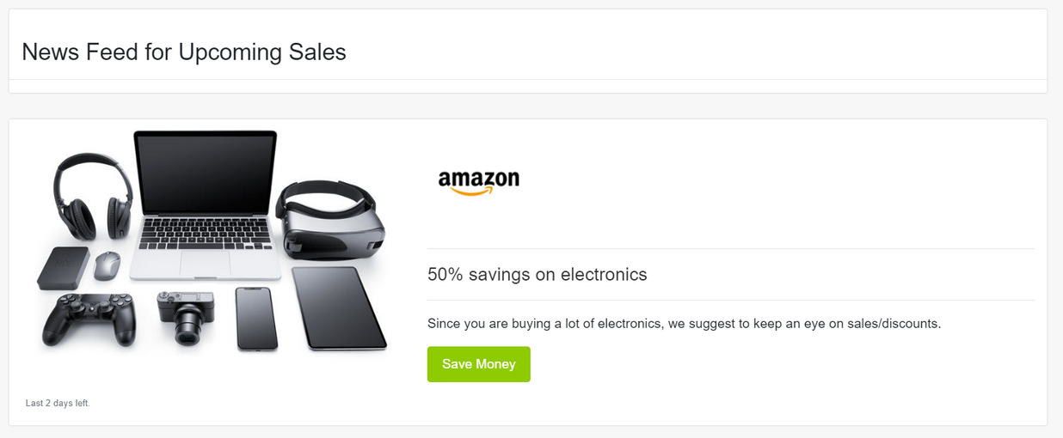
Features
3
Add and track your Goals.
4
Get a customized news feed.

Slide 11





SWOT Analysis
STRENGTHS
WEAKNESS
Unique features like OCR scanning
User friendly UI
Easy analysis of data
Need to provide all services free for the initial period
OPPORTUNITIES
THREATS
Add new features like sending notifications and tips
Add Machine Learning capabilities for data analysis
Some spending trackers already exist but with less features

Slide 12
FUTURE PROSPECTS
Action 1
Building an ML model that studies your expenditure pattern and displays all the coupon codes to enhance your savings.
Achieving our ultimate goal does not happen overnight. It’s the totality of small, individual milestones added up together. This project's future roadmap will help us visualize the small milestones we need to complete to achieve our ultimate goal.
We will also identify blockers that could prevent us from moving forward and come up with practical solutions to address those blockers.
To fulfill this we will be completing the following mentioned goals in future.
Action 2
Tips based on monthly expenditure so as to manage finances wisely
Action 3
Reminders on mail regarding goals and recurring payments.
WE AIM TO IMPLEMENT THESE FEATURES IN PHASE 2 OF OUR PROJECT

Slide 13

WORKING PROTOTYPE
Here is the video link of our project.

Slide 14
"The advance of technology is based on making it fit in so that you don't really even notice it, so it's part of everyday life.”
Thank you!
Have a great
day ahead.

